Slide 1


Integrated Computer Vision and Radio Frequency Classification System

Slide 2




Who We Are:
Company Description: CIAN WRITES. Unfortunately, they recommend talking about how new the company is, what you can produce now (very little), and what you plan to produce ( a lot)
Cian Mansfield
Computer Engineering
Former Flight Test Engineer w/ the USAF’s 96th Operations Group;
Current FTE with Autonodyne LLC
Founder & President of the National Defense Society, Founder of Balor
Aditya Singh
Aeronautical and Astronautical Engineering
Lead Engineer of the NDS CUAS Systems Engineer Intern at Leonardo DRS (C-UAS and Missile Interceptor Teams)
Zachary Kirkeby
Computer Science
Former R&D Intern at Sandia, SWE Intern at Northrop Grumman, Security Researcher, Security and RF expert, Cybersecurity Lead for NDS
Michael Lamiman
Honors Computer Engineering
Power Systems and Automation Intern at Nucor, CV expert, Former NASA Quantum computing intern, Targeting Lead for NDS CUAS

Slide 3
Executive Summary
A two part system combining a full band Radio Frequency Scanner and a Turret Mounted CV system, integrated with an Edge AI and networked with short range communications
This system is man portable, and can be deployed by individual personnel on the battlefield or in the civilian world, and immediately begin collecting data on the UAS systems in the area
The Process:
Radio Frequency Scanners perform initial detection, and determines target direction, heading, and collects communication data
Computer Vision System then points at, and collects in-depth visual data on the target
Edge AI uses the collected data to recommend individual system response, and communicate with other units to create a cohesive, live view of the operating space
Something here maybe
Something here maybe

Slide 4

DOD Mission Needs
We focus on tackling these specific DOD Mission Needs:
Deepen our Understanding and Awareness of Unmanned Systems Trends and Threat
How can we gain a greater understanding of unmanned systems and their deployment, threats, and use cases?
Defend Against Unmanned Systems Threats to U.S. Interests
How can we improve our active and passive defenses by clarifying, streamlining, and delegating responses?
Develop New Avenues to Enable Novel AI Integrations into Modern Systems
How can we leverage AI technologies to enhance modern systems?
Enhance our Situational Awareness Across the Full RF Spectrum in Real Time
How can we capitalize on emerging technologies to improve our situational awareness?
Note: Sourced from DOD Strategy Fact Sheet on Countering Unmanned Systems / DARPA SBIR

Slide 5
Computer Vision - Core Functionality in CUAS
CV's Role in Integrated Drone Defense
Computer Vision serves as the intelligent core of the proposed Counter-UAS (CUAS) system, transforming raw sensor data into actionable intelligence for threat assessment and response.
Input: Live video feed from a turret-mounted camera, directed by RF scanner data (target direction, velocity, direction of travel).
Objective: Rapid, accurate, and autonomous identification, tracking, and characterization of airborne targets to enable effective defensive measures.
Integration: Seamlessly integrates with RF detection for initial cueing and subsequent weapon system recommendations.
Output: Real-time data streams including target classification, threat assessment, tracking parameters, and recommended interdiction strategies.

Slide 6
Computer Vision - Target Identification & Tracking
Precision Detection and Classification
The CV model performs multi-class classification and robust tracking to differentiate legitimate airborne objects from potential threats, ensuring minimal false positives.
Primary Identification:
UAV: Classifies various system types (quadcopters, fixed-wing, custom builds).
Non-UAV: Identifies common benign airborne objects (birds, civilian aircraft, balloons, debris).
Tracking Capabilities:
Persistent Tracking: Maintains lock on detected targets despite challenging environmental conditions (e.g., varying light, weather, occlusions).
Kinetic State Estimation: Determines precise real-time position, velocity, and acceleration vectors.
Trajectory Prediction: Predicts future path of the target based on observed movement patterns and dynamics.
Technology Foundation:
Utilizes advanced deep learning architectures (e.g., CNNs, Transformers) trained on diverse datasets of aerial objects.
Employs object detection (e.g., YOLO, Faster R-CNN) and multi-object tracking (e.g., DeepSORT) algorithms.
Leverages edge computing for low-latency processing directly on or near the turret.

Slide 7
Full Spectrum RF Scanner - Core Functionality
RF Analysis’ Role in Integrated Drone Defense
RF analysis, in the form of a full spectrum RF Scanner serves as the long range intelligence gathering mechanism of the proposed CUAS system for threat identification, triangulation, and classification.
Input: Live RF signals from antenna arrays provide overlapping zones of data collection, enabling real time awareness over the full RF spectrum.
Objective: Real time insights into RF activity, enabling classification, identification and triangulation of targets to enable effective defensive measures.
Integration: Seamlessly integrates with CV analysis and EdgeAI threat assessments for situational awareness, threat trajectories, and anomalous activities.
Output: Real-time data streams, including activity across different RF bands, communication types (burst, encrypted, intermittent, continuous), and communication trends over time.

Slide 8
RF - Target Triangulation & Tracking
Precision Detection and Classification
The CV model performs multi-class classification and robust tracking to differentiate legitimate airborne objects from potential threats, ensuring minimal false positives.
Primary Identification:
Potential UAV: Identified based on their RF communications, frequency band, and communication type
Civilian: Identifies common frequencies associated with civilian and general RF noise
Military: Identifies frequencies and behaviors commonly indicating military action
Tracking Capabilities:
Persistent Awareness: Maintains awareness across the full RF spectrum regardless of weather
Triangulation: Determines relative position based off delay in RF reception across communication arrays
Trajectory Prediction: Predicts future path of the target based on shifts from triangulated data
Technology Foundation:
High tech readiness level, utilizing state of the art antenna arrays and a wide range of options for RF receivers.
Employs established noise filtration algorithms and triangulation techniques like Time Difference of Arrival (TDoA) and Angle of Arrival (AoA).
Leverages efficient software defined radio technology for portability and efficiency

Slide 9
RF - Spectrum Analysis and Pattern of Life
Situational Awareness and Anomaly Detection
The CV model performs multi-class classification and robust tracking to differentiate legitimate airborne objects from potential threats, ensuring minimal false positives.
Pattern of Life:
Anomaly Detection: Identifies typical behaviors, allowing for detection of non standard transmissions
Noise Filtration: Filtration of white noise and benign signals to focus on adversarial action
Operational Awareness:
Long Term Intelligence: Maintains awareness of communications both hostile and benign across a wide range
Signal Analysis: Determines risk and use case based off burst signatures, indicators of channel hopping, encryption, all of which are visible across the RF Spectrum
Full Spectrum: Counters frequency hopping and counterintelligence efforts by identifying patterns moving in synch across the spectrum.
Resilient:
Adversarial jamming efforts deny the adversary use of the same frequency bands
Detects jamming attempts based off anomalous RF patterns
Leverages algorithms like Relativistic Average Generative Adversarial Networks (RaGAN) to filter out noise and adversarial jamming efforts.

Slide 10
Edge AI: Intelligent Fusion for CUAS
Comprehensive RF and CV Analysis on the Edge
Key Message: Our Edge AI system provides robust, end-to-end pipeline for multi-modal analysis by intelligently integrating data from RF scanners and turret-mounted Computer Vision (CV) cameras, enabling precise target identification, real-time threat assessment, and coordinated response for Counter-UAS (CUAS) operations.
Radio Frequency (RF) Analysis & AI-Enhanced Intelligence:.
AI Enhancements: Edge AI actively processes RF data for Trend Analysis, Noise Injection & Spoofing Detection, and Discrete Pattern Recognition to provide early warning and precise cues as well as aiding in establishing a pattern of life for observed entities.
Computer Vision (CV) Analysis & Detailed Visual Assessment:
Guided Precision: RF data precisely points the turret-mounted CV system towards the target.
Visual Intelligence: Edge AI's CV models analyze live video for target identification (e.g., drone type, bird), real-time tracking (position, velocity), and trajectory prediction.
Edge AI Integration, Recommendation & Networked Operations:
Multi-Modal Fusion: Edge AI fuses intelligence from both RF (e.g., trend, spoofing, patterns) and CV (e.g., visual ID, tracking, behavior) for a comprehensive understanding.
Actionable Insights: Determines threat level (e.g., approaching high, leaving low) and recommends suitable weapon responses and actions (e.g., kinetic, laser, missile).
Situational Awareness: Leverages short-range communications to network with other units, sharing processed data for a cohesive, live operational picture.

Slide 11
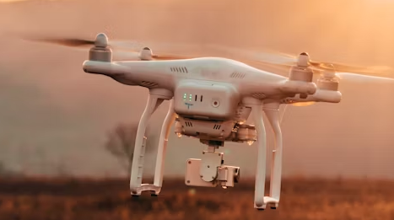
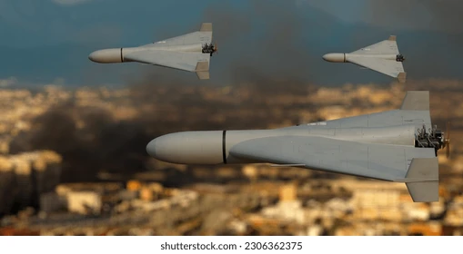
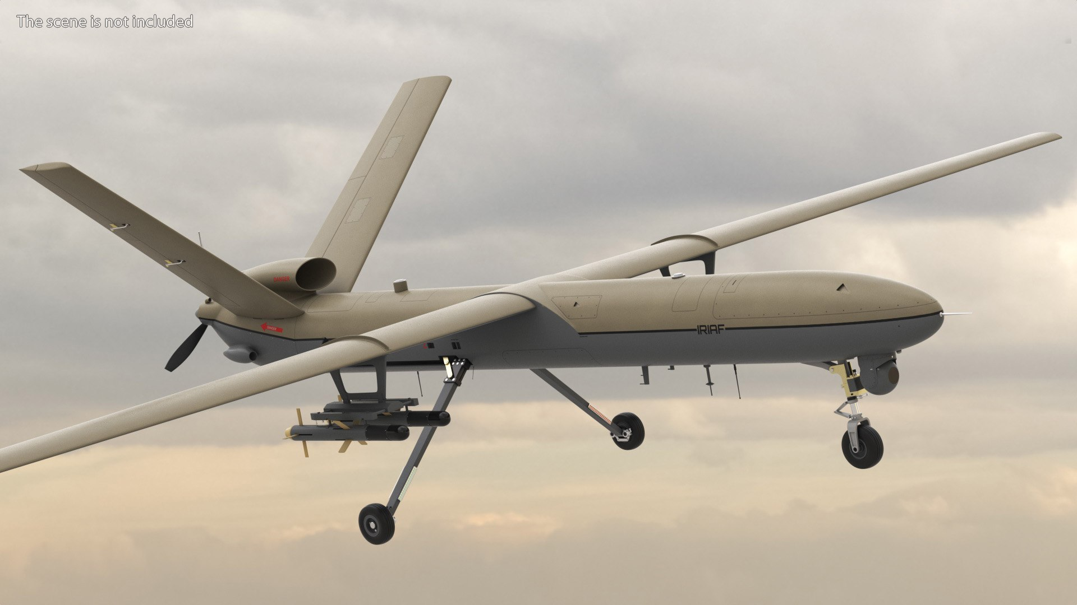
Usage Example - Military
Collected Information
Response Recommendation
Unarmed, slow, unencrypted data
Directed Energy/Electronic Warfare
Quick, attack trajectory encrypted comms
Kinetic Destroy
Armed, advanced, faraway
Guided Missile
Notes:
May remove

Slide 12
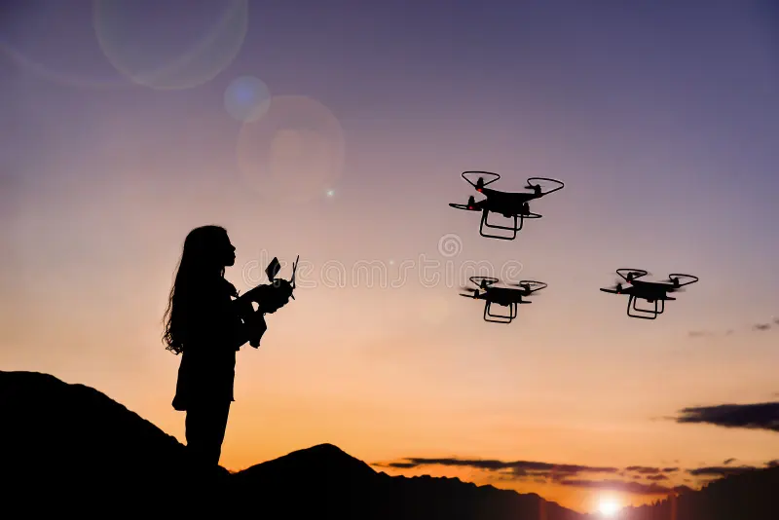
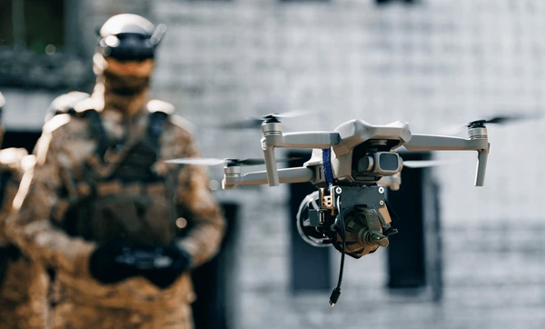
Usage Example - Civilian
Collected Information
Response Recommendation
Unencrypted data, low UAV count, non-hostile trajectory near public events (i.e. stadium)
No response
Notify response personnel, recommend increased alertness level
Suspicious noise on unusual frequencies, coordinated movements near high value targets (i.e. political rally)
Notes:
May remove

Slide 13
How we meet DOD Needs
Deepen our Understanding and Awareness of Unmanned Systems Trends and Threat
RF Scanners and CV can collect a wealth of relevant information:
Deployment methods and trends: How are these systems fielded?
Patterns between communications and attacks: What radio signals are precursors to attacks?
Location specific data: Are certain frequency bands being used in one area but not another? Are certain locations more prone to recon or kamikaze systems?
Defend Against Unmanned Systems Threats to U.S. Interests
How can we improve our active and passive defenses by clarifying, streamlining, and delegating responses?
Clarification: Based on data, more effective rules can be established
Streamlining: Threat categorization and response recommendation can be carried out by computers instead of human personnel, speeding up response time
Delegation: The system provides personnel with all the relevant information, delegating all but the final decision away from personnel.

Slide 14
Prototyping Feasibility
The primary technologies (Radio Frequency/Computer Vision) are well developed and field tested with a wealth of existing options on scanners and cameras to choose from
Primary development will occur in gathering existing data sets and training the Edge AI, meaning large quantity of work can be done without equipment
Components can be studied without purchase, allowing for rapid restructuring. Physical devices are only needed for system integration and testing.
Usage of entirely off-the-shelf components means straightforward production, no need for advanced manufacturing facilities, allowing for easy scaling

Slide 15
Feedback Adaptability
The usage of an Edge AI allows for different data collection methods to easily be integrated
On DIU recommendation, technologies like radar, acoustic detection, etc. can easily be integrated by changing the training data and format for the edge AI system
ADD MORE, THIS IS A REQUIRED CAPABILITY (MICHAEL AND ZACH)
Edge AI can identify discrete patterns, identifying subtle frequency hops and jamming techniques
Identification of potential threats in seemingly benign data
Analysis of rapid and advanced signal obfuscation techniques across the spectrum
Edge ai optimizes targeting, classification, and anomaly detection to unify multiple datastreams for high fidelity decision making
Reduces false positive rate
Rapid identification matching the best elimination method to the target
Evolves with the area and emergence of new technologies
Identifies emerging trends and anomalies
Responsive to environmental stimuli and changing battlefield tactics

